Slide 1
Input to campaign functions for 132nd website
Campaign functions
Current As Of (CAO): 5. August 0800Z

Slide 2
Priniciples
Reduce amount of steps (”clicking”), or time consuming tasks as much as possible
However, at the start/before the campaign start, it can be alot, as it can be handled by mission designer before campaign start
Realistic approach, but adjusted to 132nd need and manpower
Time spent on analysis and planning, not on plotting (VIS/JFACC)
Make it easy to setup events/run missions from week to week.
Giving focus on mission planning and mission editing
Endstate: ”Create the most realistic and immersive MP campaign in DCS”

Slide 3
Create orders (AOD, JAOP, Operations order)
Create intelligence summaries (VIS)
Create intelligence reports
Plus intel injects (higher VID reports)
Build enemy order of battle (down to Battalion)
Air Force, IADS, ground forces, ships.
Different countries
JFACC roles, AOC roles, VIS roles
TGT list (master target list)
Target folders
JPTL list
Per event
Intelligence / BDA reporting part of AAR
Campaign objectives
Broken down into phases?
Request for Information (RFI) function and tracker
Information requirements tracker
IR attached to taskings? Can then be answered by that flight in aar?

Slide 4
Mission designer workspace
Weather forecast. Current and next 3 events
A way to input the current weather on a event, and and the forecasted weather for the next 3 events. Can be normal plaintext.
Need to be visible and available to everyone attending events (Pilots, VIS and JFACC)
Maintenance situation
A way to input if certain assets are down (AWACS/Tankers). Can for example be a extra option for mission designer in the air asset function (Might already be there with ”State”?)
If a asset are down, it should not be availble for tasking (so temporary not possible to select that asset)
Should be a way to set how long the asset are down (D+1 to D+3 for example)
Need to be visible for JFACC as a minium, but desired for everyone to be able to see it.
Logistical situation
A way to input (freetext) information about the logistical situation (low number of a certain type of missiles, etc
Need to be visible for JFACC as a minium, but desired for everyone to be able to see it.

Slide 5
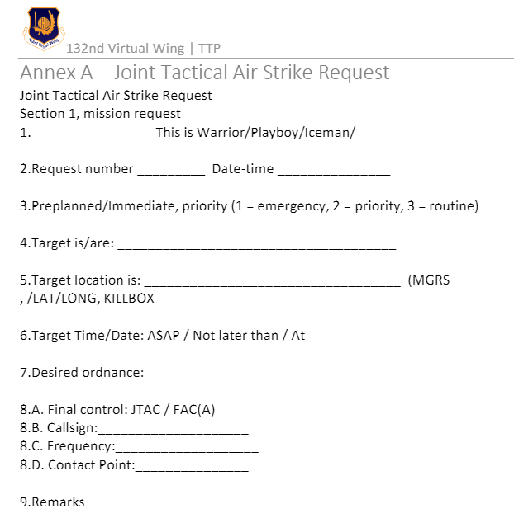
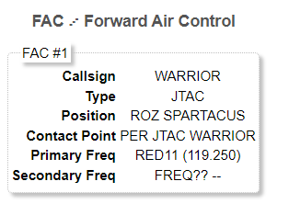
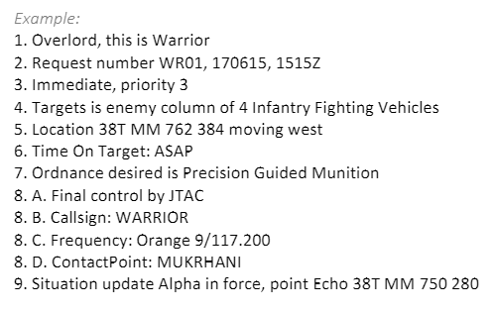
Mission designer workspace
Air Request
It would be ideal with a function/form on the website in the workspace for Mission designer/event host to submit a air request that goes to JFACC for processing. The current air request form is shown on picture to the right (From AWACS TTP).
Ideally it should also be possible for a JTAC to submit this in case a JTAC want to take part in the mission, based on the mission brief or availability. So maybe a JTAC usergroup, which also contains this functioin?
The idea is that mission designer/host is able to inject stuff into the mission in a natural way, so the JFACC need to handle it and take it into their priorities
All Air request should end up in a table visible for all participants, with the status from JFACC shown.
The idea is also that once JFACC process the air request, it will automaticly create a tasking on the ATO (Draft ATO) based on this request. It will then ideally fill out the FAC data information in the tasking (See picture below, right)
In line 1:
Option 1: Use JTAC callsign (from dropdown after JTACs have been added as assets, see below) . This will create a CAS tasking
Option 2: is a request from Corps Commander (Ground Force Commander in a area) (maybe also added as a asset?), this will create a AR tasking
Line 2: Requestnumber (as identifier, in the table with all requests) should start with DX (X0 day of the event, for example D01, or D10, then it should be the first and last letter in the callsign or unit (for Corps Commanders), for example WR=Warrior, AN= Assassin, following by rising number for the amount of air requests from that specific callsign. So a full request number will be : D03WR01 = D+3, Warrior, request number 1.
Date-time: Real world time when it is submitted
Line 3: Dropdown menu for the 3 options: 1=Emergency, 2= Priority, 3=Routine
Line 4: Freetext field
Line 5: A dropdown menu to select points already on the campaign tracker, with a optional way of manually intputting coordinates
Line 6: Select one of the three options: ASAP/Not later than/At, and add field to input data based on the selected option
Line 7: Freetext field
Line 8:
Final Control: Dropdown: JTAC/FAC(A)/SCAR
Callsign: Dropdown menu of availeble assets
Frequency: Autofilled based on asset selected above, optional a manually inputted fred. Need both primary and secondary every time (primary UHF, secondary VHF or vice verca)
Contac Point: Selected from points imported to the website. Also a option to manually input a contact point

Slide 6
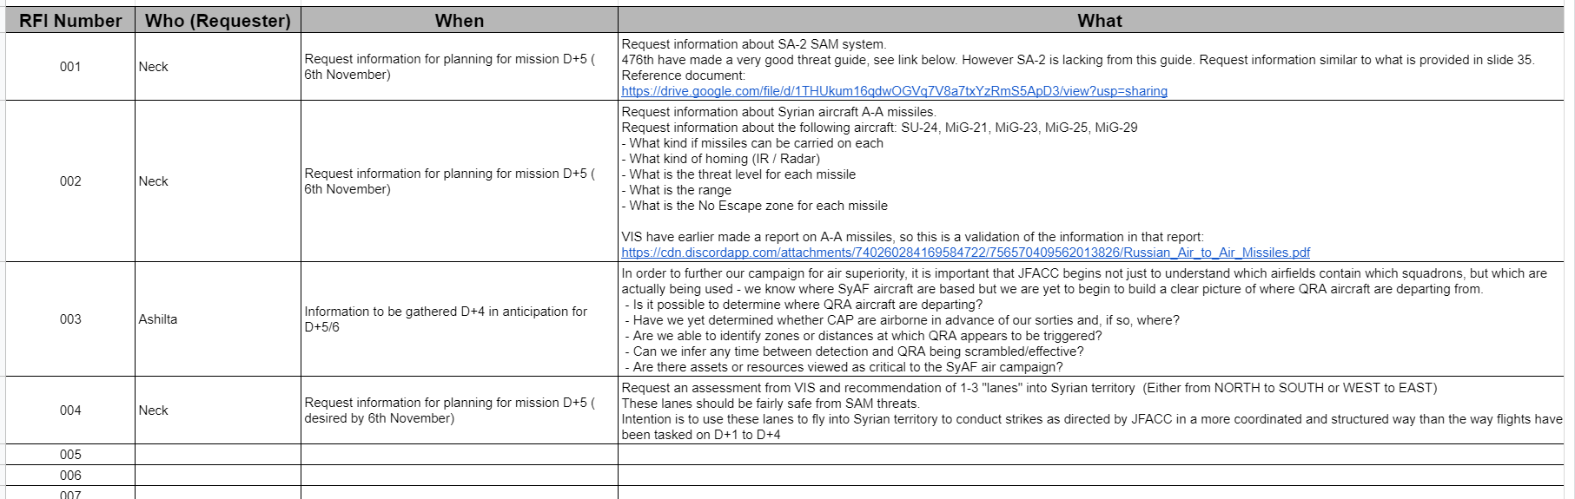
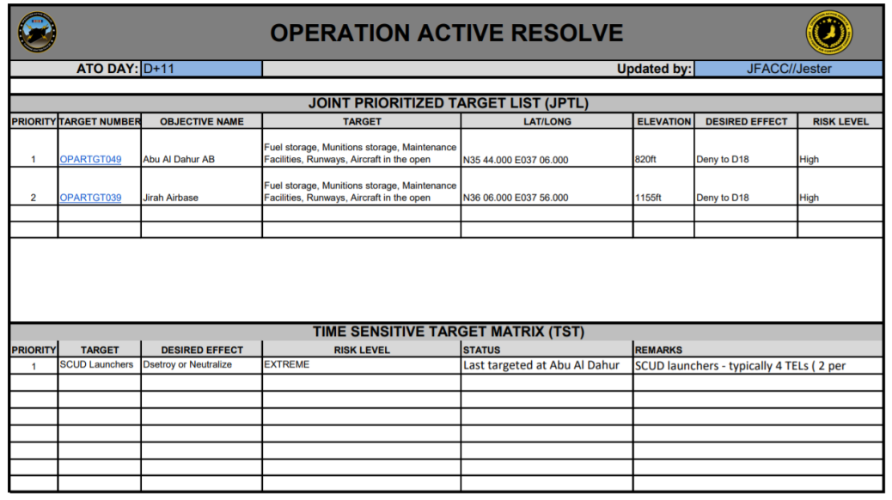
Common workspace (VIS+JFACC)
RFI tracker (Request for information tracker)
A function for pilots / everyone to ask any question to either JFACC or VIS. In order for tracability and making it easy for everyone to see it, it would be ideal if it is visible for all participants.
Can be a form that is submitted?
Should be part of Campaign View
Example to the right (but lacking who the question is for and a field for answers).
In VIS/JFACC workspaces, they need the oppertunity to write and modify answers to the RFI’s that are sent in from the participants.
Maybe have a field internally for VIS/JFACC where a individual can be assigned to answer the question (and then comes up as a alert on the website (Or a NOTAM type message, just different color)
Should have a date and time + who have answered
JPTL (Joint Prioritized Target List)
The JPTL should be tied to ATO (event). So JPTL A belongs to ATO D+1, JPTL B to ATO D+2 and so on.
Both VIS and JFACC should have the option to access to JPTL functions
Should contains fields from example from bottom right or link: https://132nd-vwing.github.io/OPAR-Brief/ORDERS/JFACC/OPAR_JOINT_TARGET_LIST_D11.pdf
Should be visible on a ATO view, or event information.
If possible, should have two versions: Draft and final. Final is approved by any of the JFACC members, but it should have a seperate button to make it published.
Also, maybe possible to work with additional JPTLs that are further out in time (so if a JFACC member have a lot of time a week, he can do the work for the next 3 events for example)
TST matrix (Time Sensitive Target)
TST matrix is not tied to a specific event, so it should be visible at all events. However, it may change from event to event, so VIS and JFACC both need the option to modify, add or delete targets on this list.
Should be visible on a ATO view, or event information.

Slide 7
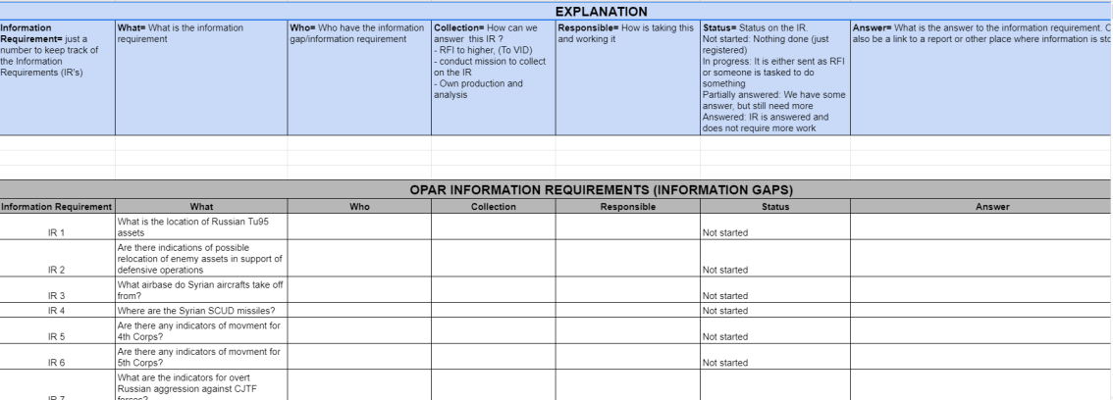
Common workspace (VIS+JFACC)
Information Requirements ( see OPAR example: https://docs.google.com/spreadsheets/d/1LViYRKN5BkhykkptcFeu4YzFzrTAWMaEXeRyeqkVcyE/edit?usp=sharing )
VIS will have information/intelligence gaps, and this will be translated to questions that can be tasked to flights as needed, that can help answer the questions in order to close the intelligence gaps.
In the shared workspace, VIS will create the questions
JFACC, as part of the tasking (ATO production) will assign the different IR(Information Requirements) to various flights

Slide 8
JFACC workspace
Air Requests (From Mission designer or JTACs)
Linked to Mission Designer Air request function (See Mission Designer workspace).
Once a air request is sent from Mission designer, the air request shows up in a table in JFACC workspace, under Air Requests.
The request should have 3 different labels: Not started/In progress/Completed
The request should have 2 answers: Supported/not supported
In the table, if possble have a button to create a tasking, that is tied to the air request. Once the tasking is up, it is added to the draft ATO similar (but takes some of the information directly from the Air request)
Once a Air request comes in, it should give a ”notam” type notification (different color)? To people in JFACC.
Campaign management
A page/function to focus on the overcall big picture management of the campaign: (maybe output of this page/workspace is the JAOP, Joint Air Operational Plan: https://132nd-vwing.github.io/OPAR-Brief/ORDERS/OPAR_JFACC_JOINT_AIR_OPERATIONS_PLAN_D1.pdf
What are the campaign objectives
Master Air Attack Plan
What are the phases of the campaign
Connect objectives to phases
Tasking (AOC)
Create draft ATO (Create event D+2, ATO D+2 , etc)
Visible who is ”Commander JFACC” for that specific event (call the shots, and can coordinate with that person as needed)
A function for mission designer or anyone from JFACC to nominate who is ”Commander JFACC” per event. Maybe a better way phrase it is 1 person i JFACC, the rest are JFACC staff. (So what we today have called JFACC is JFACC staff, and JFACC is the commander on that specific event)
ATO document, with all taskings (For everyone involved to get a overall SA, especially AWACS controllers).
To have reference / link to all important documents:
AOD, JPTL, SPINS, Daily spins
ACO: Automatic generation of ACO together with ATO (Based on the Airspace Control Plan (CombatFlite masterfile)

Slide 9
JFACC workspace
JAOP (Joint Air Operations Plan)
This is the planning document created by JFACC prior to the campaign, and only reviewed and/or updated during changes in phases in the campaign.
Can be tied to the campaign management see previous slide
Example from OPAR: https://132nd-vwing.github.io/OPAR-Brief/ORDERS/OPAR_JFACC_JOINT_AIR_OPERATIONS_PLAN_D1.pdf
Feature request: A way to create this document for JFACC prior to starting the campaign, and as necessary adjust/update it for phase changes or when reciving new guidance from mission designer.
This document should also be availeble for everyone to read, so it should be accessible somewhere. Maybe create a subpage for documents/orders? And keep a list there of all relevant orders
AOD (Air Operations Directive)
This is the planning document created by JFACC for each event, which translates the current situation, the guidance given, previous actions, availeble intelligence into the guidance for the ATO day (next event)
Example from OPAR: https://132nd-vwing.github.io/OPAR-Brief/ORDERS/JFACC/OPAR_JFACC_AOD_D11.pdf
Feature request: A way to create this document for JFACC prior to each event (start of the planning process. See suggestions for workflow later in this document)
This document should be read by everyone, so it should be accessible somewhere. Maybe create a subpage for documents/orders? And keep a list there of all relevant orders?
SPINS document (Special Instructions)
This is a instructions to all particpants regulating operations in the campaign (both tactical and administrative). This is valid for all events unless otherwise directed.
Example from OPAR: https://132nd-vwing.github.io/OPAR-Brief/MISSION%20INFORMATION/OPAR%20JFACC%20STANDING%20SPINS.pdf
Feature request: A way to create this document for JFACC and mission designer.
The document need to be read by everyone participating in the campaign (maybe have something like the NOTAM system, where it keep track of who have read and acknowledged it?)
All of these documents can be created in word or google docs, and just be a hyperlink if that is easier/better. The advantage of having them on the website can be to integrate it into other functions on the website, such as the objectives, assets, etc.
Also, just keeping everything organic, and have people work only on the website is very ideal and desired

Slide 10
VIS Workspace
Create intelligence summary
Create intelligence report
Enemy order of battle (BDA)
Ground forces
Air Forces
Air Defence Forces (IADS)
Naval forces
Master target list
ICR Intelligence Collection Requirement
Drafts , that can be attached to flights on the ATO

Slide 11
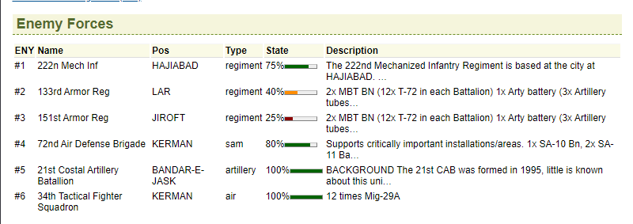
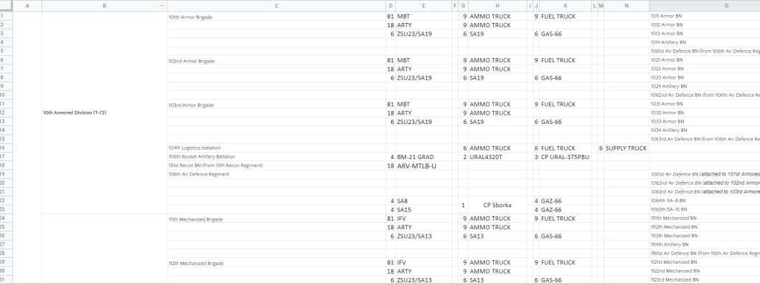
INTEL / VIS: Enemy order of battle
A list/function to show the enemy forces.
Ideally it should be able to show enemy forces, broken down in the following:
Ground Forces
Air Forces
Air Defense Forces
Naval Forces
For all forces, it should be able to break down / split up the units so the lowest unit is either battalion or company. For example see picture bottom right or this link: https://drive.google.com/file/d/1iwW3iR-q_dpTVp3p-121SfFY0BL-Ipd5/view?usp=sharing
Ideally a graphical representation and % as shown on the picture to the top right
VIS Function: For VIS it should be easy to go in and adjust the numbers based on the BDA (for example in a armored division as shown on the picture bottom right).

Slide 12
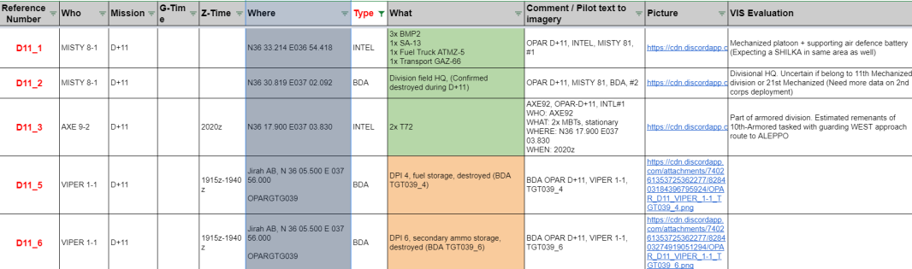
AAR -> Reported information table
In the AAR, have a seperate section for Intelligence and BDA to make sure pilots do not mix up the two, making it harder for VIS to see what is what.
Ideally the reported information from Intelligence and BDA sections on the AAR exports into a reported information ”masterlist” / table that is availeble on the website. (Example OPAR: https://docs.google.com/spreadsheets/d/1x_R9hlsiJ6ziDbQpDIugntAisaQUk6diqUeznc2akyw/edit?usp=sharing ) Also see picture bottom right.
Each of the pilots observations should be a seperate entry (so maybe the AAR format need to be changed to facilitate that?)
Maybe have location as a mandatory point for Intelligence and BDA in AAR?
Suggest also to have option to use IVO and freetext the location, for example a city
If given in bullseye, then website will automaticly translate it into a coordinate (see below) in the master reported information table
Function where a pilot can add a bulls location, and the website then calculate the real position
Mission designer or JFACC can set Bullseye position somewhere on the website (SPINS), and the website can use this to calculate the location? This will then feed into VIS
Example: https://www.fcc.gov/media/radio/find-terminal-coordinates
https://www.youtube.com/watch?v=IVz4f36xwUs
Related comment/suggestion from VIS member: ”I really like the idea that web site should calculate the A/C coordinates based upon bulleye. It's a good step in the right direction. Ideally it should also be able to calculate the INTEL based on the calculated A/C position. Many reports; "DIRT SA-2 5 o'clock, own position BE 089/120, own heading 320". It may not be 100% accurate but using DIRT/MUD for inner ring on RWR would be preferred”
Ideally , the output of this (after manual adjustments) from VIS, is that the masterlist (for that event) can be exported and create points for a file that can be opened in combatflite with the locations and observations. This will save a lot of time and effort and will be a gamechanger! (Very important function!!)
On the campaign have a function to give a notification automaticly to pilots that have not filled in anything in the AAR after 2-3 days after the event. (To ensure the intel is getting int). Maybe a NOTAM kind of message?
In order to generate the master reported information table, it should be a button in the VIS workspace to pull the information from the AAR and populate the reported information table. Once it is done, the information will not be changed even though AAR’s change. (Then it manually need to be changed by VIS or mission designer.
In the reported information table the what should have an option to have different colors, to make it easier to separate for VIS. For example: Air Forces, Air Defence Forces(IADS), Ground Forces, Naval forces, other countries.
The reported information table should be able to be viewed as whole (all events), or a single event

Slide 13
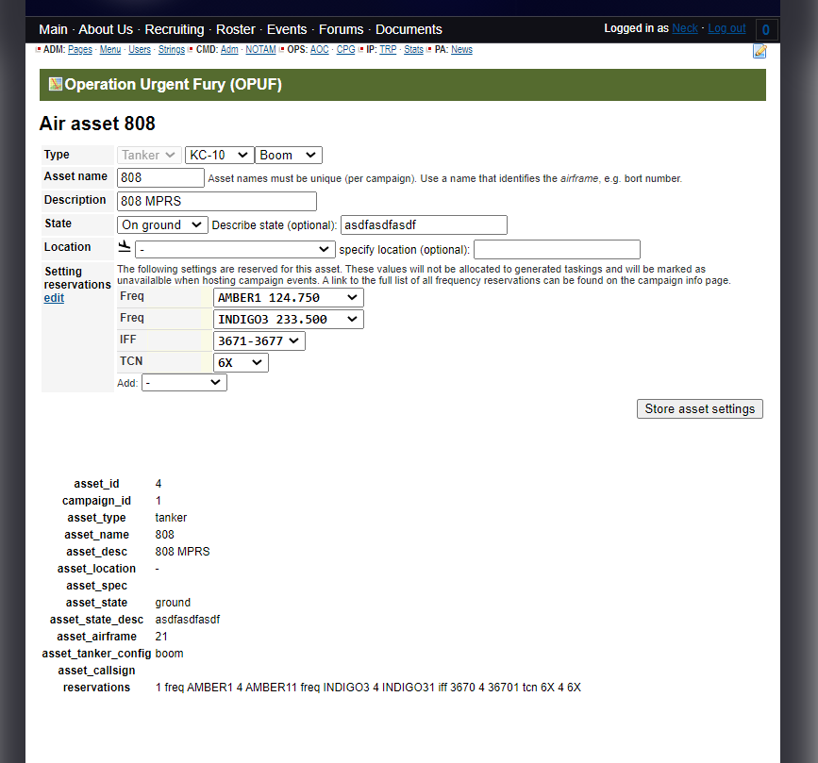
OTHER
Change from FAC to JTAC (Forward Air Controller to Joint Terminal Attack Controller) for taskings for CAS with a ground controller
Add FAC(A) for CAS with a air controller
JTAC added as asset
It should be possible to add various JTACs (with freqs) as assets similar to AWACS/Tankers in order to reserve/block the freqs and make sure they have the necessary freqs to do CAS.
As show on picture on the right
Corps Commanders added as asset
It should be possible to add various Corps Commanders (With freqs) as assets similar to AWACS/Tankers in order to reserver/block the freqs and make sure they have the necessary freqs to do AR.
As show on picture on the right
A list for mission designers and JFACC to see ”Free frequencies” (not used by assets, or tasked to anyone on the ATO)
With new access system, if possible, make a role for event host, so one do not need to be IP to host events. Right now for example we have former IP’s that are ”only” MQ, but still host events.

Slide 14
Workflow suggestion? JFACC
An idea is to setup a form of workflow for JFACC per event, taking it through various steps (different pages?)
Rationale is to streamline the process, giving the tools to support the process, and avoid time on formatting and finding information. Focus is spent on planning and how to solve it. Website supports with the process
Ideally one such workflow is availeble per event (ATO day), so future days can be worked with in advance aswell, as drafts.
Endstate of the workflow is a approved ATO, approved JPTL, approved AOD, approved ACO
Example:
Step 1: Verify objectives (make sure they are still valid)
Step 2: Verify TST matrix (make sure it is still valid)
Step 3: Review Information Requirement (IR) (to know what information gaps/questions/areas that are of interest to VIS)
Step 4: Determine JPTL (Which targets are prioritized targets for this event)
Step 5: Process Air Requests (From JTACs and Corps Commanders – sent by mission designer)
Step 6: Write AOD (Air Operations Directive) (Example AOD: https://132nd-vwing.github.io/OPAR-Brief/ORDERS/JFACC/OPAR_JFACC_AOD_D11.pdf )
Step 7: Create taskings (ATO) determine what airspaces are active (ACO)
Step 8: Assign specific IR’s to the taskings that are created

Slide 15
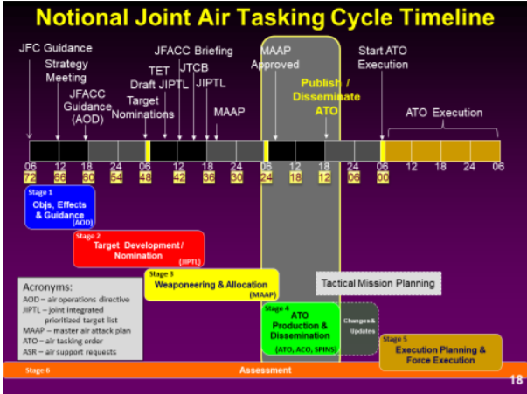
Workflow suggestion? JFACC - Alternative
The workflow is setup so at any time there are 4 ATOs (events) in in work at any given time. The ATO / event is in various degree of readiness. Because we do this for fun, we do not need to spread the work evenly for each event, so if someone have time, they can finish off the preperations for multiple events at one time, and then just publish the drafts as final when the time for the event comes.
ATO A: Stage 1: Review JFC guidance, verify objectives –
Output: AOD
ATO B: Stage 2: Create JPTL + TST matrix
Output: JPTL + TST matrix
ATO C: Stage 3: Allocation + Process Air Requests
Output: Master Air Attack Plan: Broad overview of flights to tasks
ATO D: Stage 4: ATO production, detailed taskings
Output: ATO , ACO and SPINS
ATO D is the next event, all products to be approved and published minium 72 hours (real world) hours from the event

Slide 16
Workflow suggestion? VIS
An idea is to setup a form of workflow for VIS per event, taking it through various steps (different pages?)
Rationale is to streamline the process, giving the tools to support the process, and avoid time on formatting and finding information. Focus is spent on planning and how to solve it. Website supports with the process
Ideally one such workflow is availeble per event (ATO day), so there is tracability, and one can go back and look at previous steps if needed
Endstate of the workflow is a updated master reported information table (which contain all reported information/intelligence and BDA), Intelligence summary’s produced, combatflite threat file updated, Input to TST matrix and JPTL provided to JFACC’s workflow, intelligence gaps identified and forwarded as ICR to JFACC for addition to the ATO for relevant flights
Example:
Step 1: Make sure all AAR’s are filled out
Step 2: Export information from AAR’s (Reported information/intelligence and BDA) to reported information masterlist/table
Step 3: Review information in reported information masterlist/table (to make sure there are no errors, and the file is ready to be exported)
Step 4: Export from reported information masterlist/table to a file that can be opened in CombatFlite. Gives locations for all observations and BDA from the AAR
Step 5: Write INTSUM (Freetext on website)
Step 6: Update Information Requirements (what intelligence gaps / questions are still unanswered)
Step 7: Suggest targets for JPTL
Step 8: Suggets targets for TST matrix/review TST matrix

Slide 17
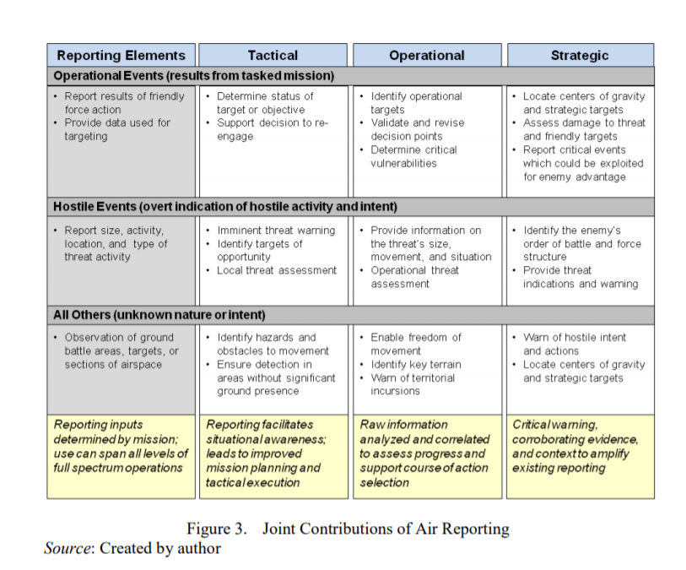
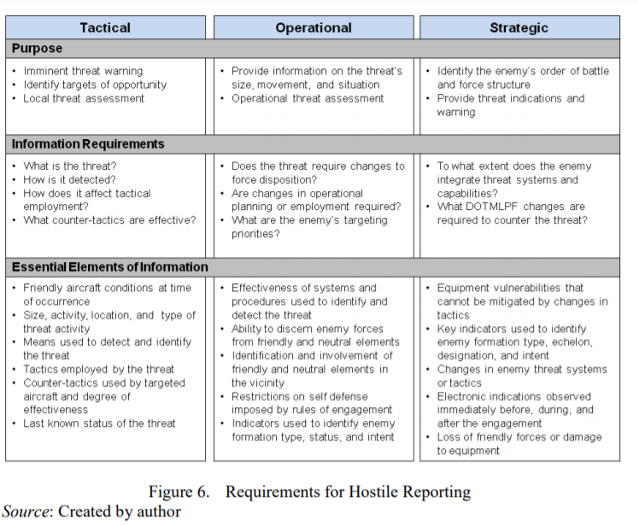
For reference

